Slide 1

Spring Core

Slide 2
Agenda
Dependency Injection
Spring AOP
Reading values from Property Files
Spring JDBC and Transactions

Slide 3


Slide 4
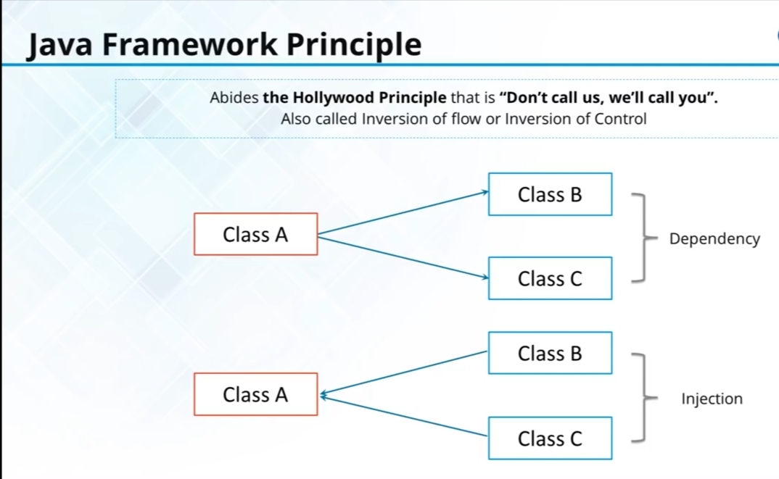

Slide 5
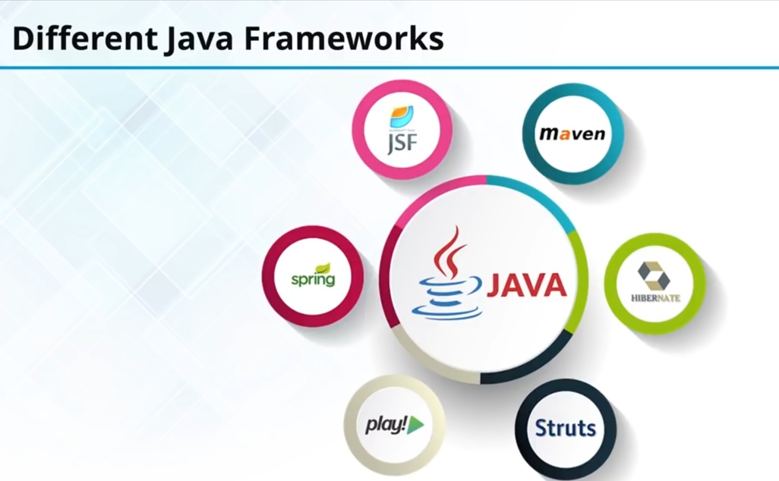

Slide 6

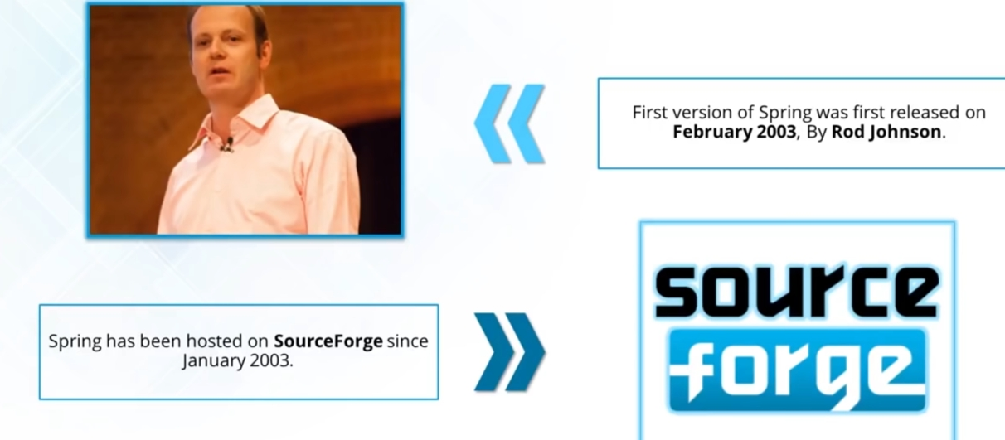

Slide 7

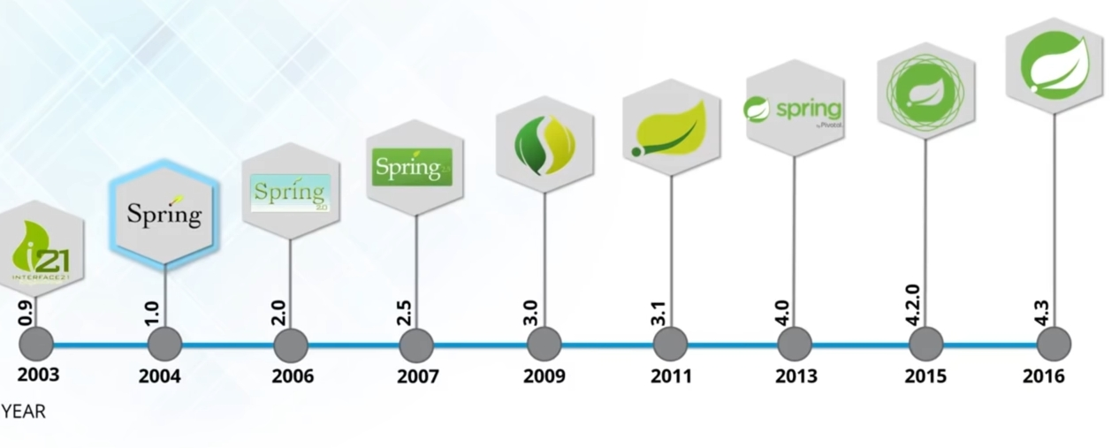

Slide 8
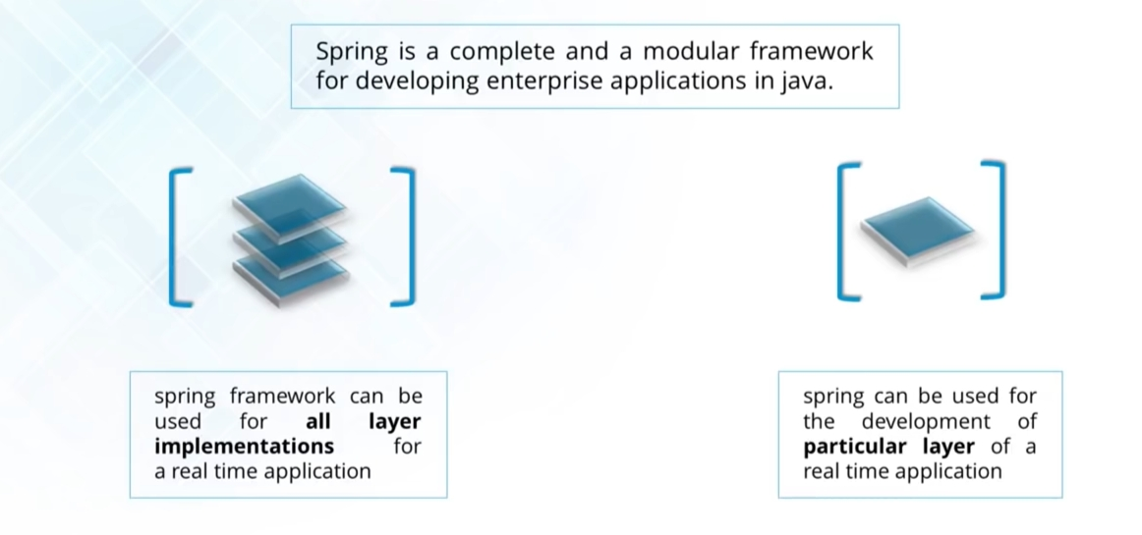

Slide 9

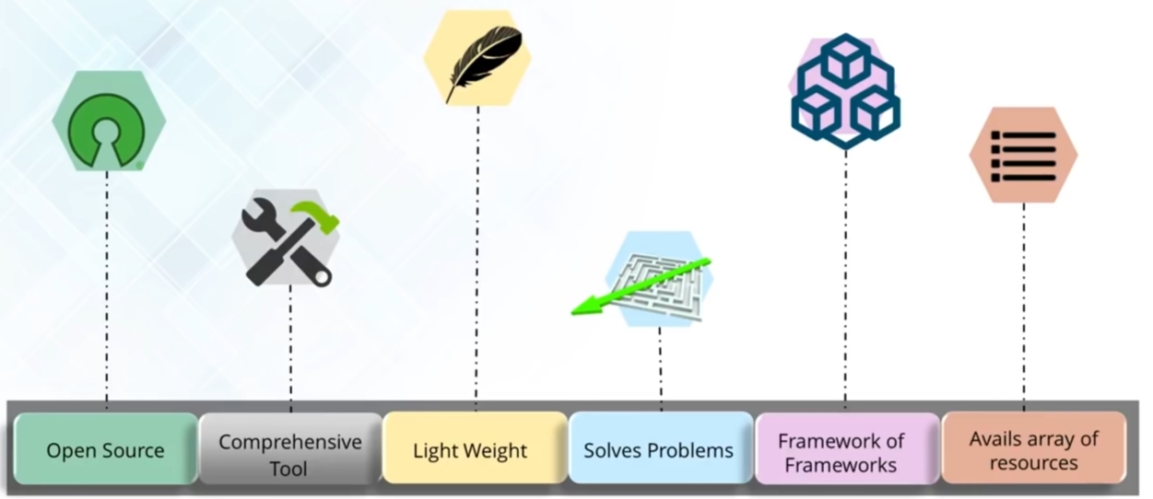

Slide 10


Slide 11

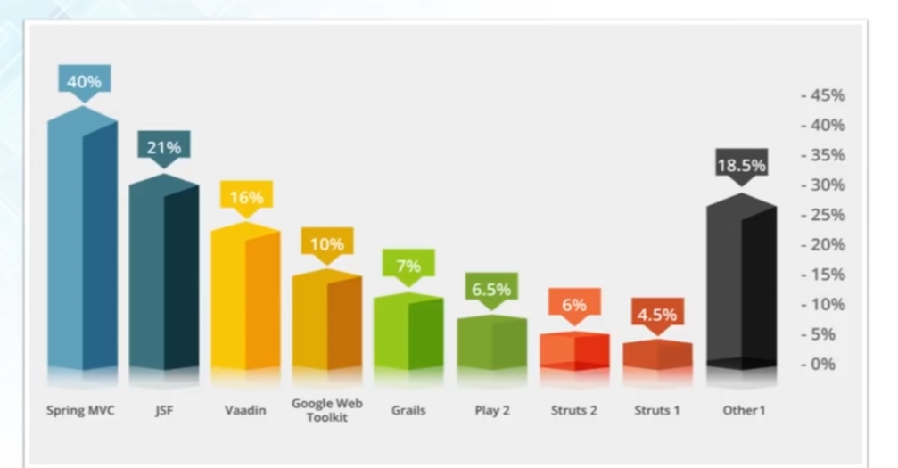

Slide 12

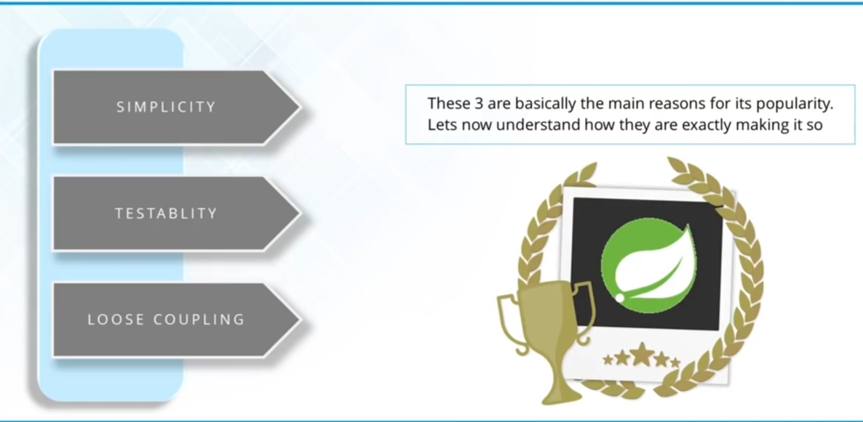

Slide 13

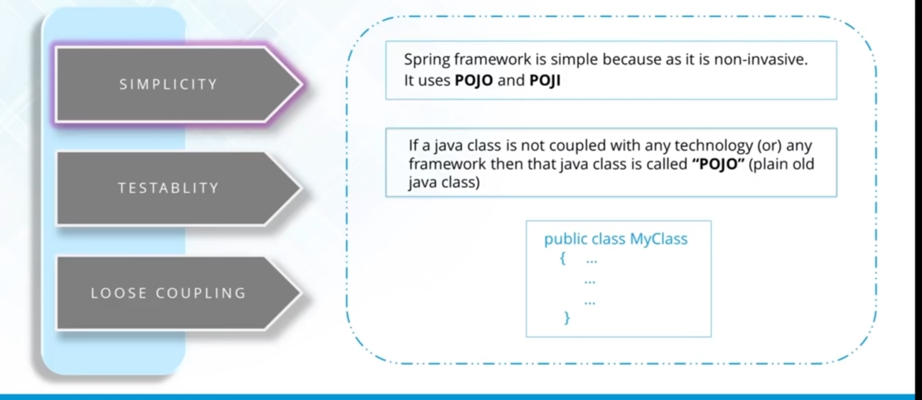

Slide 14

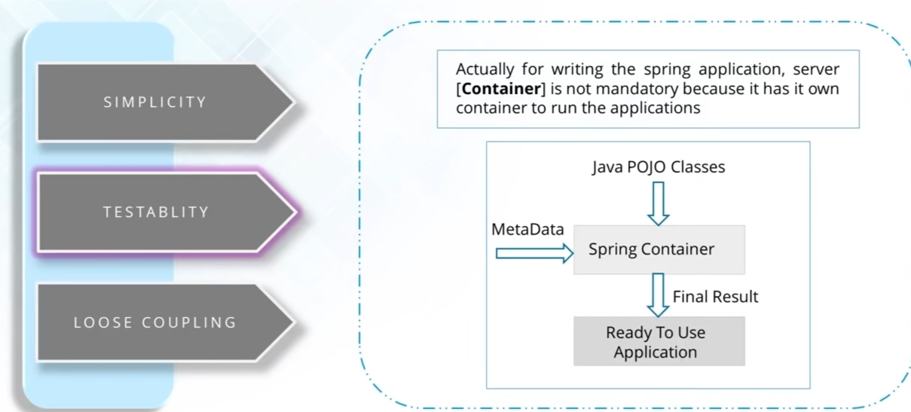

Slide 15

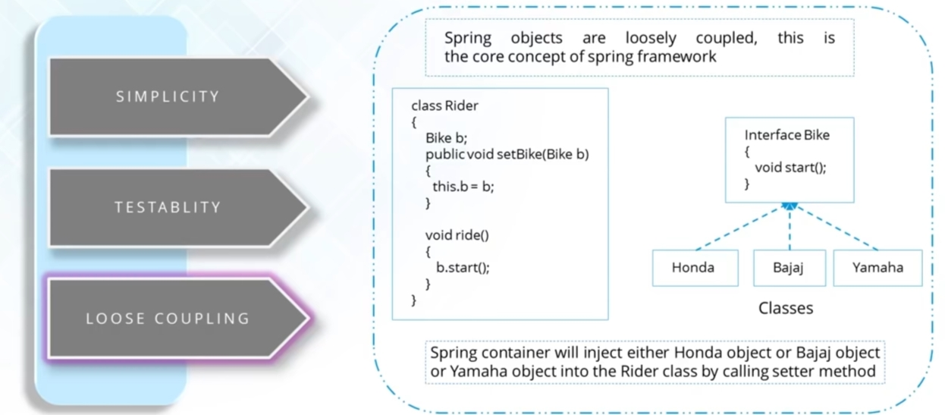

Slide 16
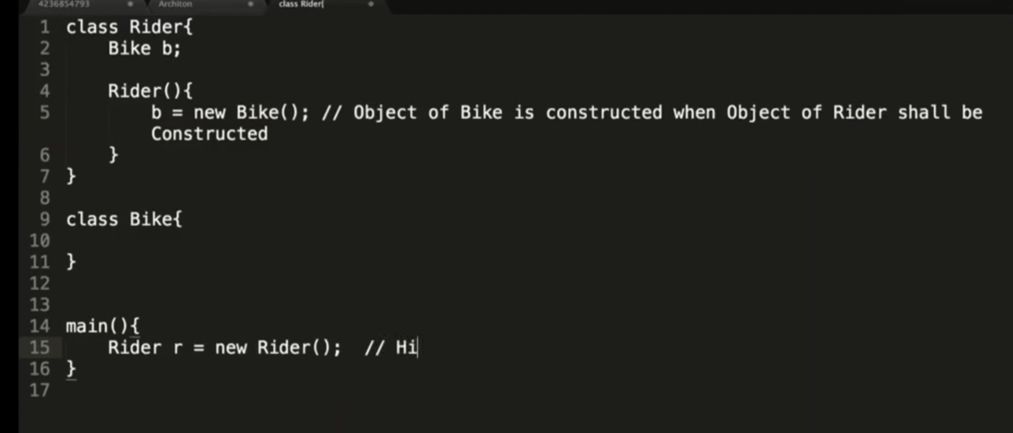

Slide 17
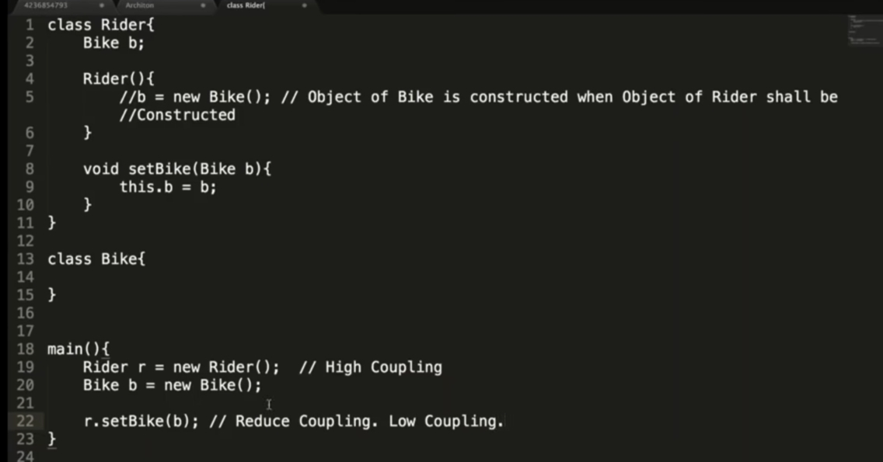

Slide 18

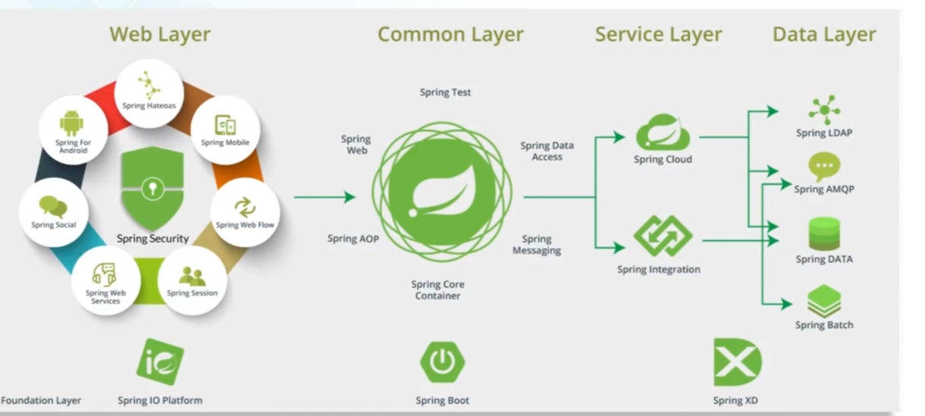

Slide 19


Slide 20
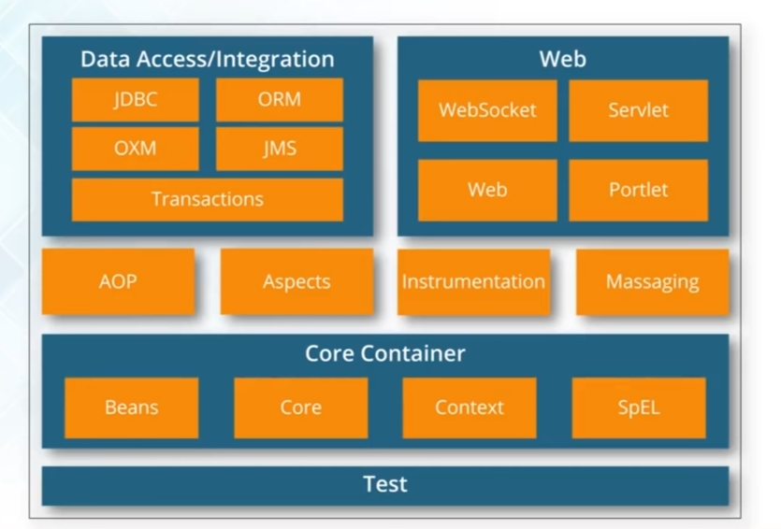

Slide 21


Slide 22

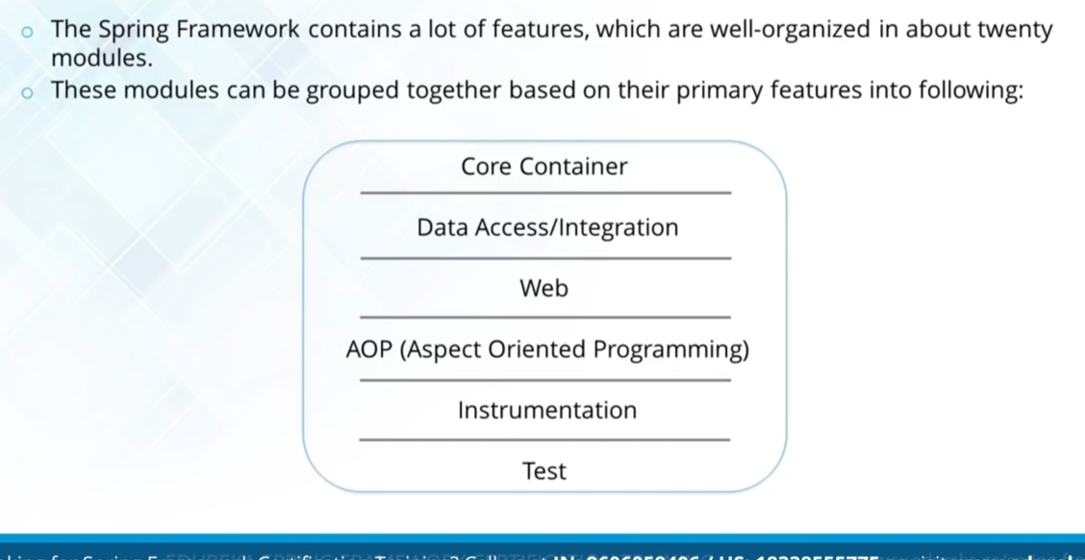

Slide 23

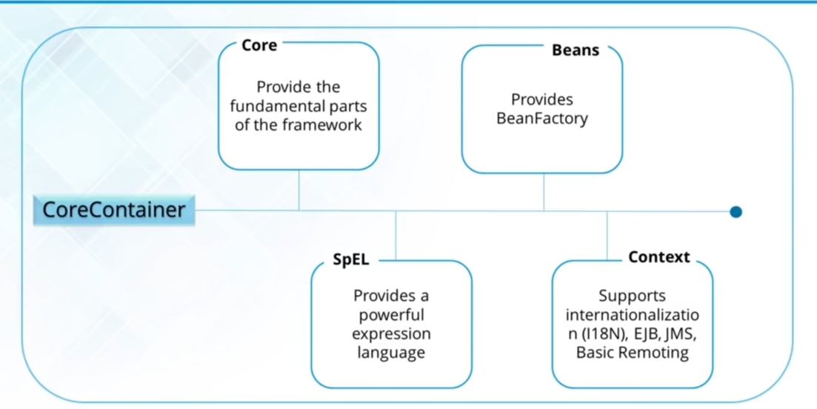

Slide 24

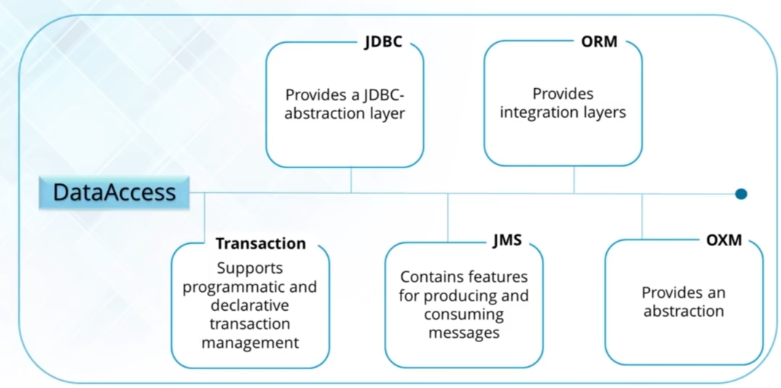

Slide 25

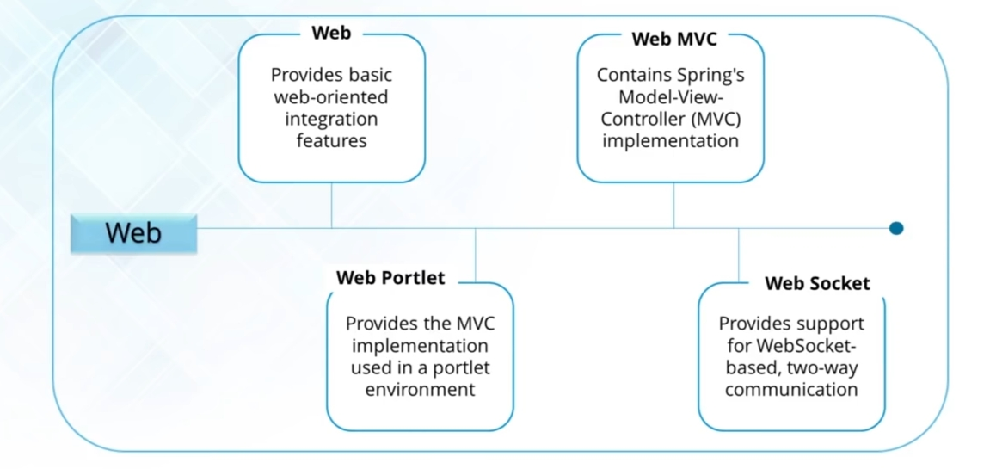

Slide 26

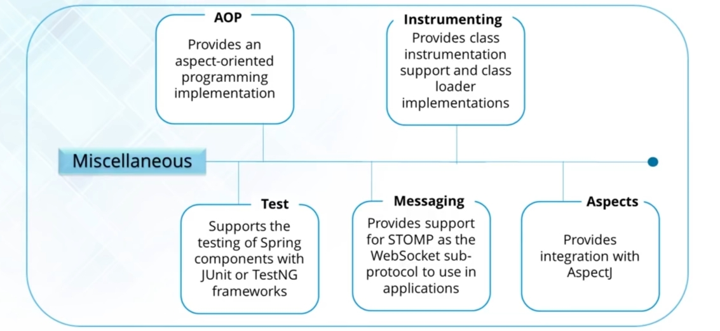

Slide 27
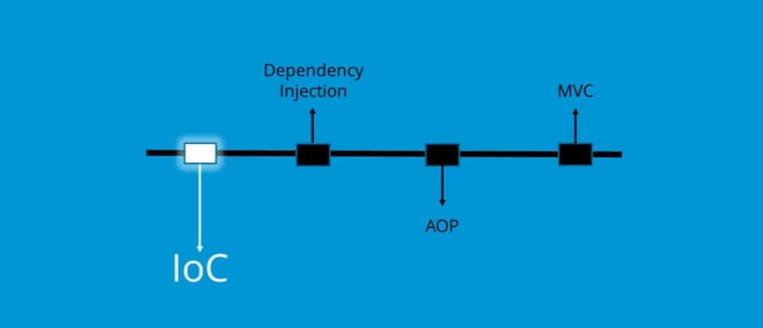

Slide 28

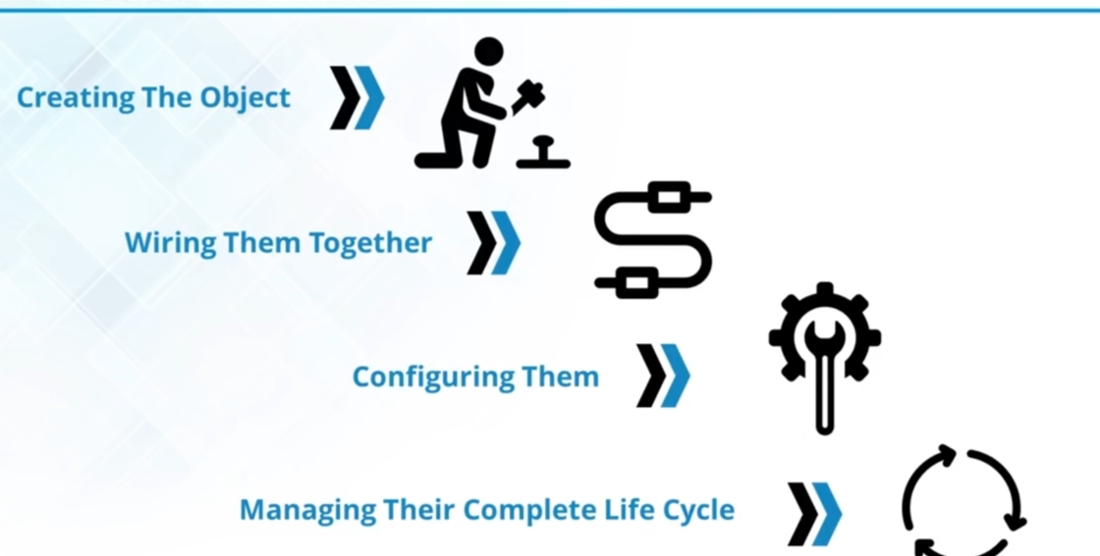

Slide 29

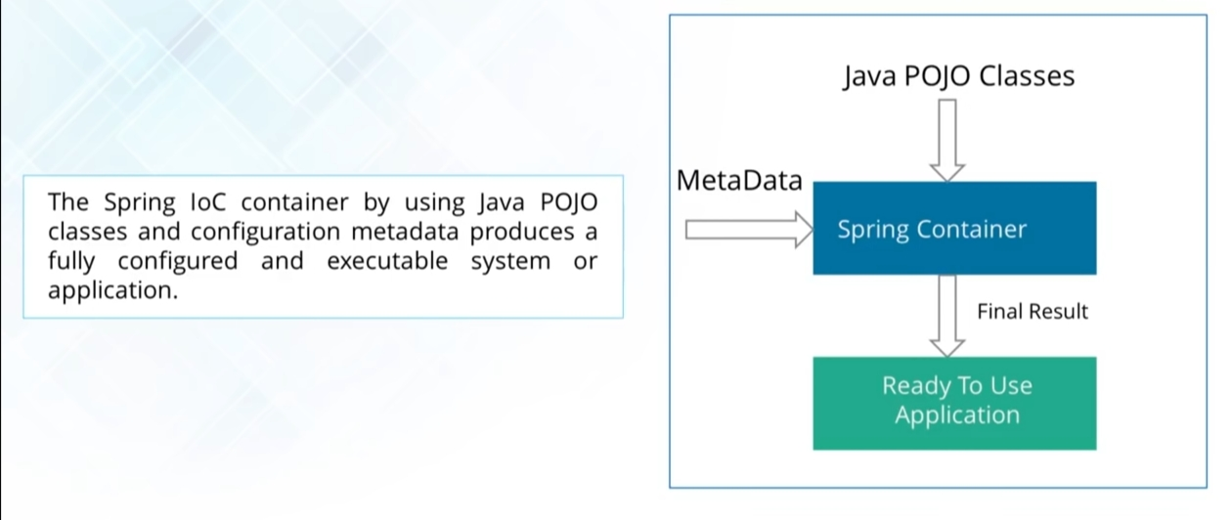

Slide 30
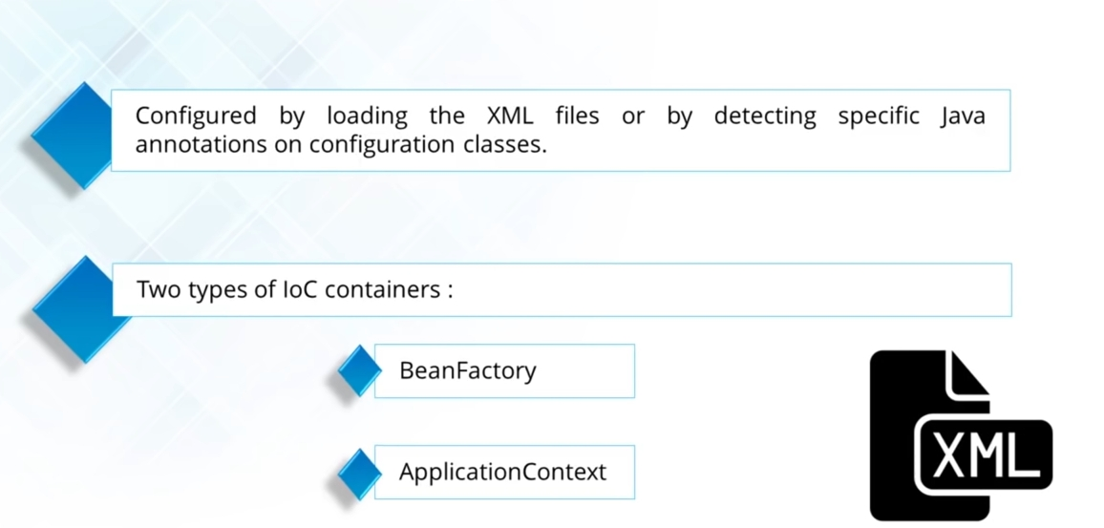

Slide 31
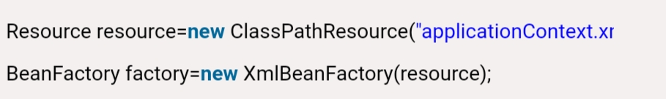
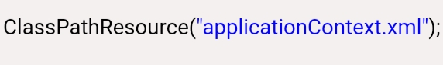
Using BeanFactory

Slide 32
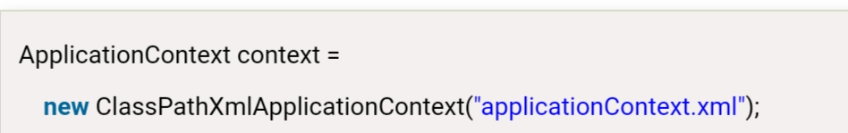
Using ApplicationContext

Slide 33




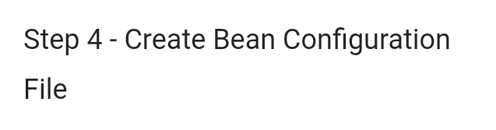


Slide 34
HelloWorld.java
package com.toot;
public class HelloWorld {
private String message;
public void setMessage(String message){
this.message = message;
}
public void getMessage(){
System.out.println("Your Message : " + message);
}
}

Slide 35
MainApp.java
package com.toot;
import org.springframework.context.ApplicationContext;
import org.springframework.context.support.ClassPathXmlApplicationContext;
public class MainApp {
public static void main(String[] args) {
ApplicationContext context = new ClassPathXmlApplicationContext("Beans.xml");
HelloWorld obj = (HelloWorld) context.getBean("helloWorld");
obj.getMessage();
}
}

Slide 36
Beans.xml
<?xml version = "1.0" encoding = "UTF-8"?>
<beans xmlns = "http://www.springframework.org/schema/beans"
xmlns:xsi = "http://www.w3.org/2001/XMLSchema-instance"
xsi:schemaLocation = "http://www.springframework.org/schema/beans
http://www.springframework.org/schema/beans/spring-beans-3.0.xsd">
<bean id = "helloWorld" class = "com.toot.HelloWorld">
<property name = "message" value = "Hello World!"/>
</bean>
</beans>

Slide 37
Output: Your Message : Hello World!

Slide 38
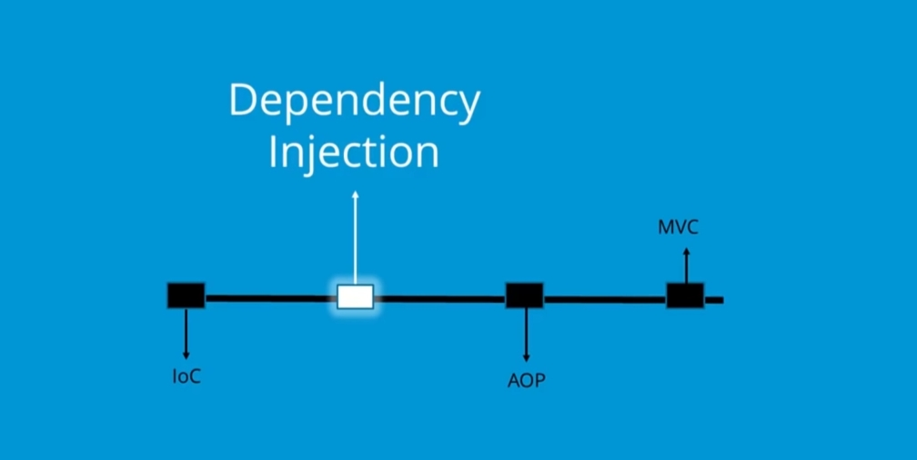

Slide 39
Dependency Injection
Setter Injection
Constructor Injection
Autowiring
Injecting Collections
Inner Beans
Inheritance, Interfaces, Scope

Slide 40
Dependency Injection in Spring
Dependency Injection (DI) is a design pattern that removes the dependency from the programming code so that it can be easy to manage and test the application.
Dependency Injection makes our programming code loosely coupled.
There are mainly two problems of dependency lookup.
tight coupling The dependency lookup approach makes the code tightly coupled. If resource is changed, we need to perform a lot of modification in the code.
Not easy for testing This approach creates a lot of problems while testing the application especially in black box testing

Slide 41

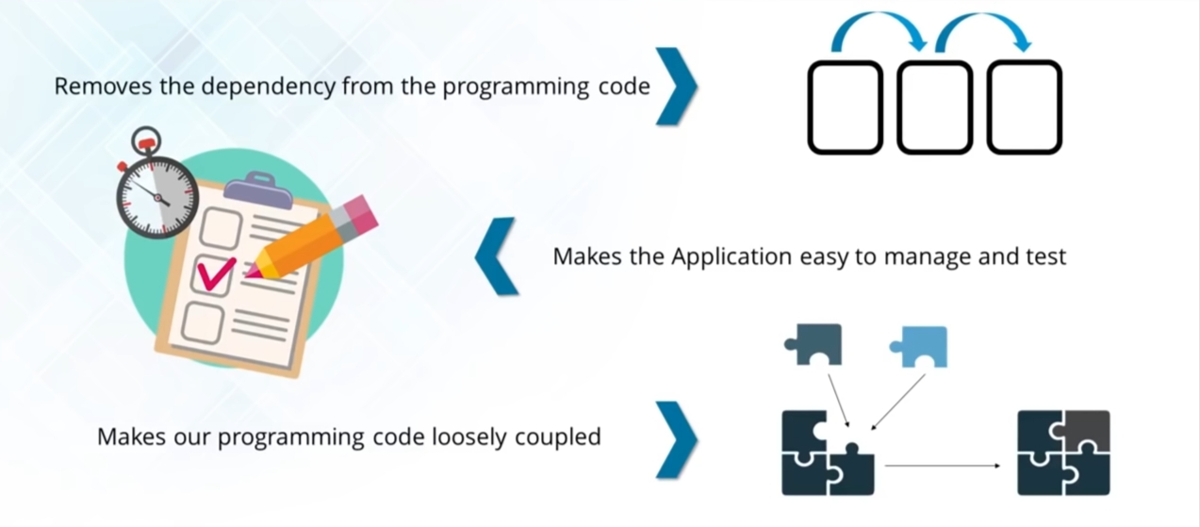

Slide 42
Two ways to perform Dependency Injection in Spring framework
By Constructor
By Setter method

Slide 43
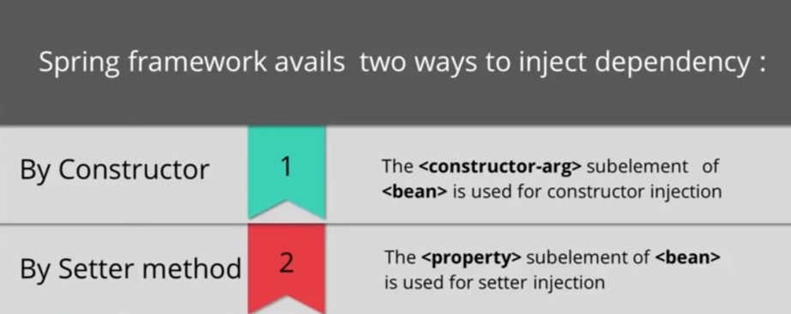

Slide 44
Autowiring in Spring
Autowiring feature of spring framework enables you to inject the object dependency implicitly.
It internally uses setter or constructor injection.
Autowiring can't be used to inject primitive and string values. It works with reference only.
Advantage-It requires the less code because we don't need to write the code to inject the dependency explicitly.
Disadvantage-No control of programmer.It can't be used for primitive and string values

Slide 45
Autowiring Modes

Slide 46
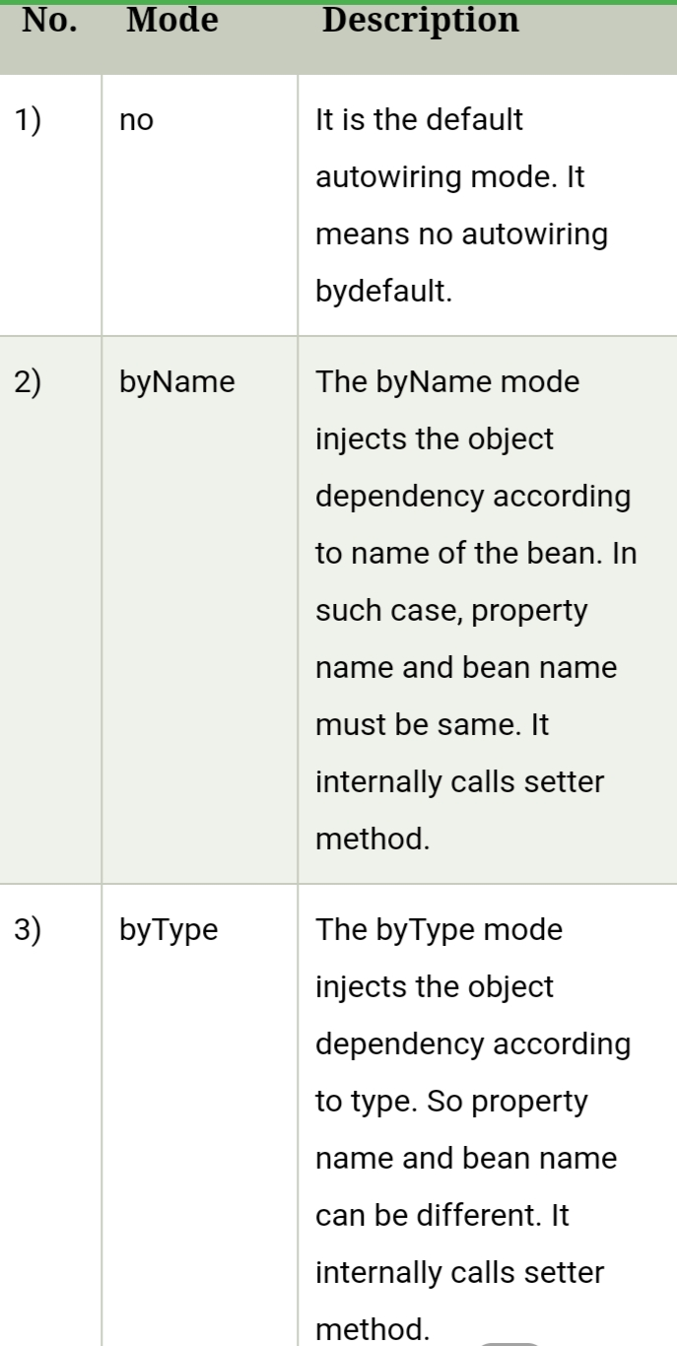

Slide 47
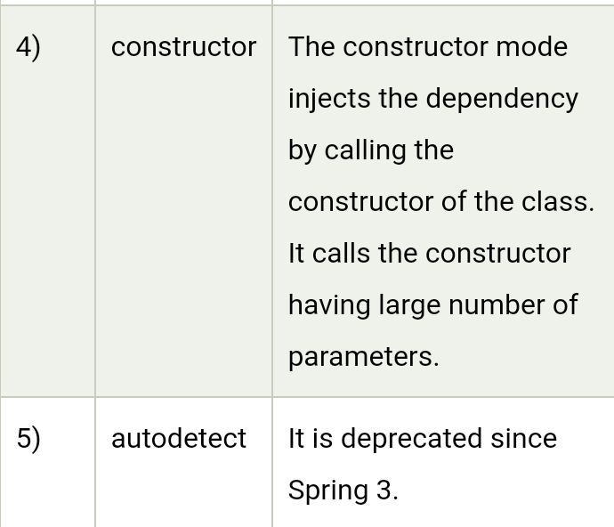

Slide 48
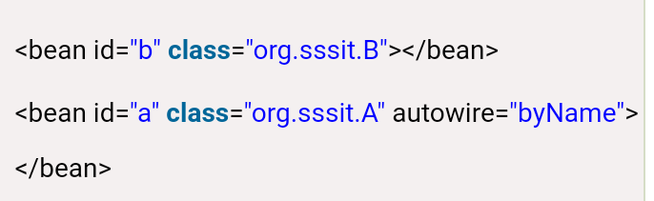
byName autowiring mode
In case of byName autowiring mode, bean id and reference name must be same.
It internally uses setter injection.

Slide 49
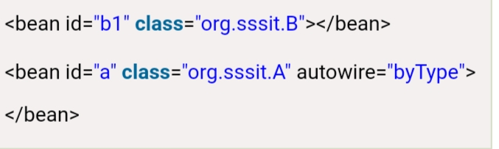
byType autowiring mode
In case of byType autowiring mode, bean id and reference name may be different. But there must be only one bean of a type.
It internally uses setter injection.

Slide 50
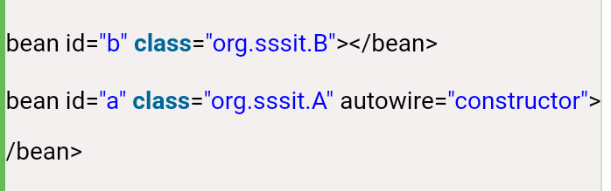
constructor autowiring mode
In case of constructor autowiring mode, spring container injects the dependency by highest parameterized constructor.
If you have 3 constructors in a class, zero-arg, one-arg and two-arg then injection will be performed by calling the two-arg constructor.

Slide 51
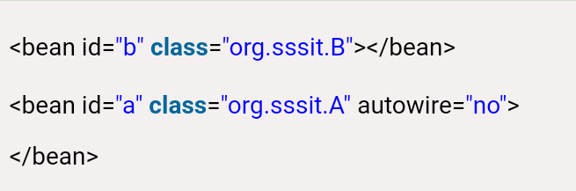
no autowiring mode
In case of no autowiring mode, spring container doesn't inject the dependency by autowiring

Slide 52
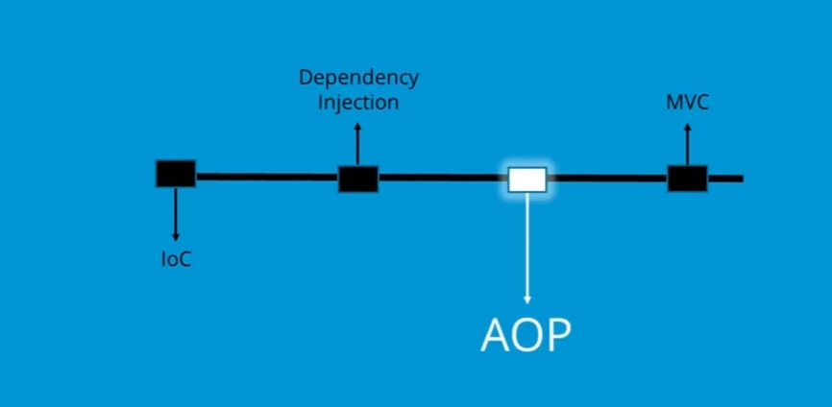

Slide 53
Spring AOP
Aspect Oriented Programming (AOP) using Spring AOP and AspectJ

Slide 54
AOP
AOP breaks the program logic into distinct parts (called concerns).
It is used to increase modularity by cross-cutting concerns.
A cross-cutting concern is a concern that can affect the whole application and should be centralized in one location in code as possible, such as transaction management, authentication, logging, security etc.

Slide 55

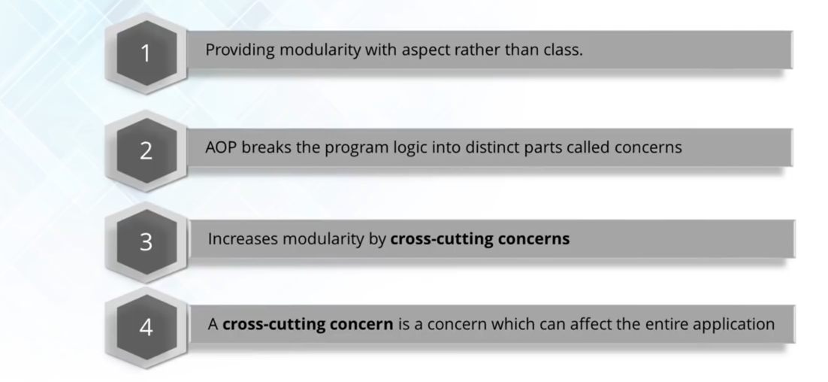

Slide 56

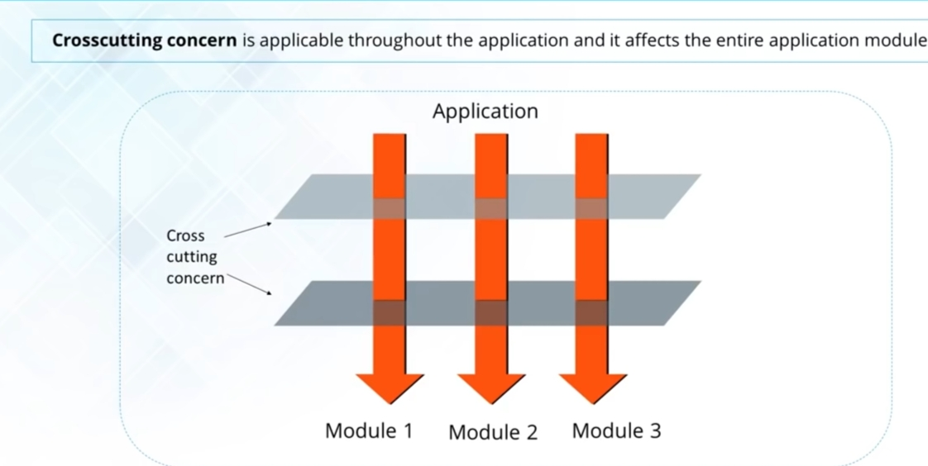

Slide 57
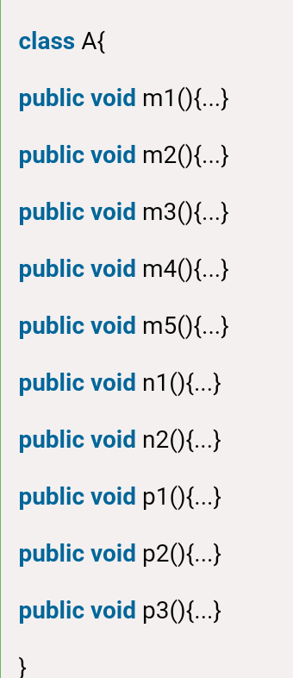

Slide 58
Where use AOP?
AOP is mostly used in following cases:
to provide declarative enterprise services such as declarative transaction management.
It allows users to implement custom aspects.

Slide 59
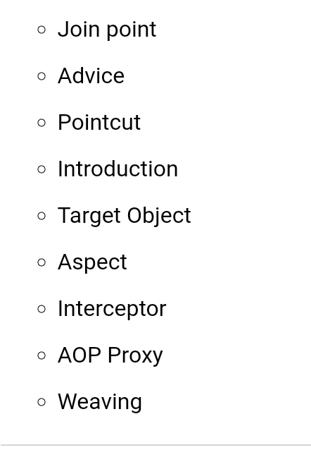
AOP Concepts and Terminology

Slide 60
Join point-Join point is any point in your program such as method execution, exception handling, field access etc. Spring supports only method execution join point.
Advice-Advice represents an action taken by an aspect at a particular join point. There are different types of advices:
Before Advice: it executes before a join point.
After Returning Advice: it executes after a joint point completes normally.
After Throwing Advice: it executes if method exits by throwing an exception.
After (finally) Advice: it executes after a join point regardless of join point exit whether normally or exceptional return.
Around Advice: It executes before and after a join point.

Slide 61
Pointcut-It is an expression language of AOP that matches join points.
Introduction-It means introduction of additional method and fields for a type. It allows you to introduce new interface to any advised object.
Target Object-It is the object i.e. being advised by one or more aspects. It is also known as proxied object in spring because Spring AOP is implemented using runtime proxies.
Aspect-It is a class that contains advices, joinpoints etc.

Slide 62
AOP Implementations
AOP implementations are provided by:
AspectJ
Spring AOP
JBoss AOP

Slide 63
Spring AOP AspectJ
There are two ways to use Spring AOP AspectJ implementation:
By annotation: We are going to learn it here.
By xml configuration (schema based): We will learn it in next page.

Slide 64
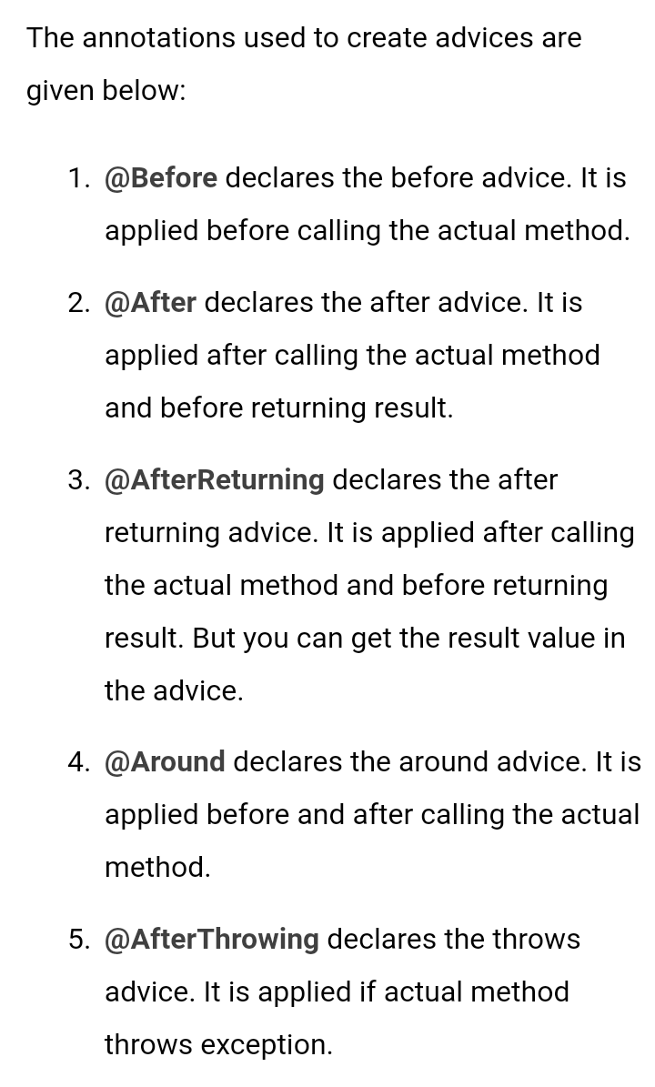

Slide 65
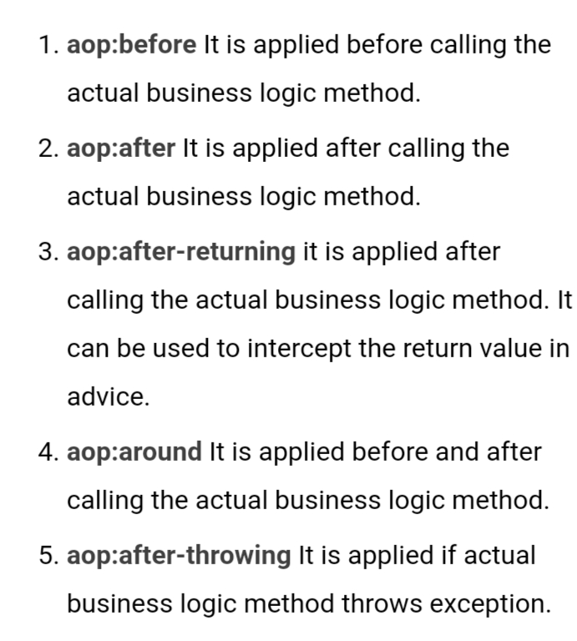

Slide 66
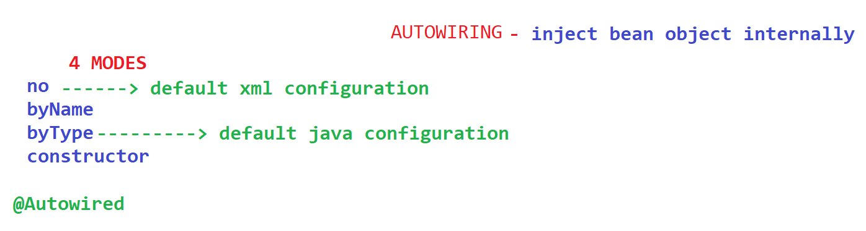

Slide 67
Spring JdbcTemplate
Spring JdbcTemplate is a powerful mechanism to connect to the database and execute SQL queries.
It internally uses JDBC api, but eliminates a lot of problems of JDBC API.
Spring Jdbc Approaches
JdbcTemplate
NamedParameterJdbcTemplate
SimpleJdbcTemplate
SimpleJdbcInsert and SimpleJdbcCall

Slide 68
JdbcTemplate class
It is the central class in the Spring JDBC support classes.
It takes care of creation and release of resources such as creating and closing of connection object etc.
So it will not lead to any problem if you forget to close the connection.
It handles the exception and provides the informative exception messages by the help of excepion classes defined in the org.springframework.dao package.

Slide 69
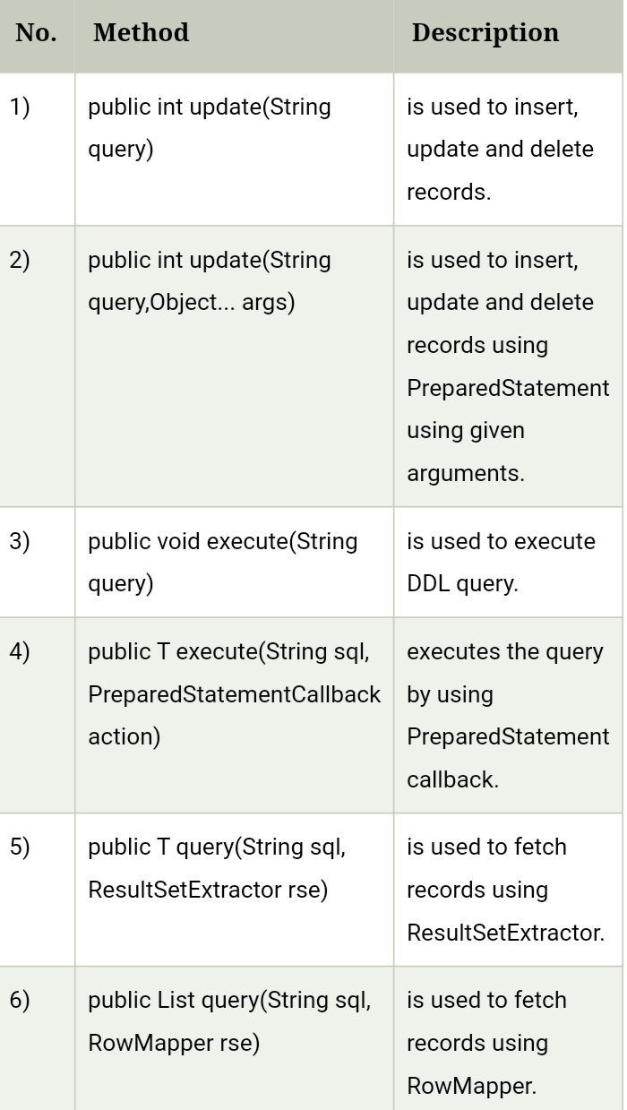

Slide 70
Spring - Transaction Management
A database transaction is a sequence of actions that are treated as a single unit of work.
These actions should either complete entirely or take no effect at all.
Transaction management is an important part of RDBMS-oriented enterprise application to ensure data integrity and consistency.
The concept of transactions can be described with the following four key properties described as ACID −

Slide 71
Atomicity − A transaction should be treated as a single unit of operation, which means either the entire sequence of operations is successful or unsuccessful.
Consistency − This represents the consistency of the referential integrity of the database, unique primary keys in tables, etc.
Isolation − There may be many transaction processing with the same data set at the same time. Each transaction should be isolated from others to prevent data corruption.
Durability − Once a transaction has completed, the results of this transaction have to be made permanent and cannot be erased from the database due to system failure.

Slide 72
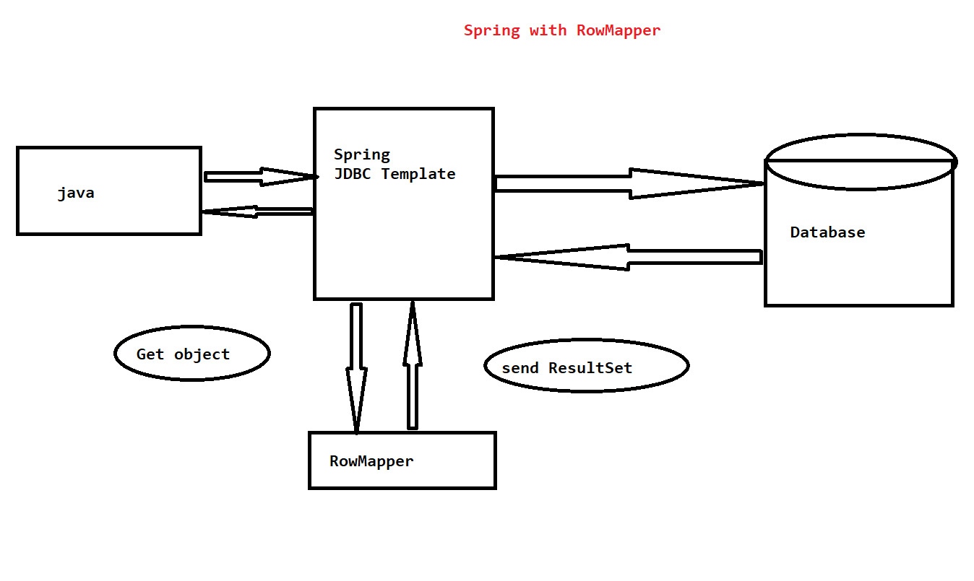

Slide 73
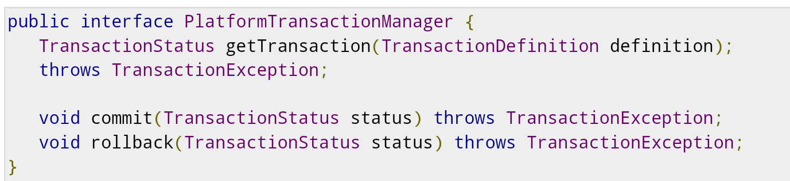
Spring Transaction Abstractions
The key to the Spring transaction abstraction is defined by the org.springframework.transaction.PlatformTransactionManager interface,

Slide 74
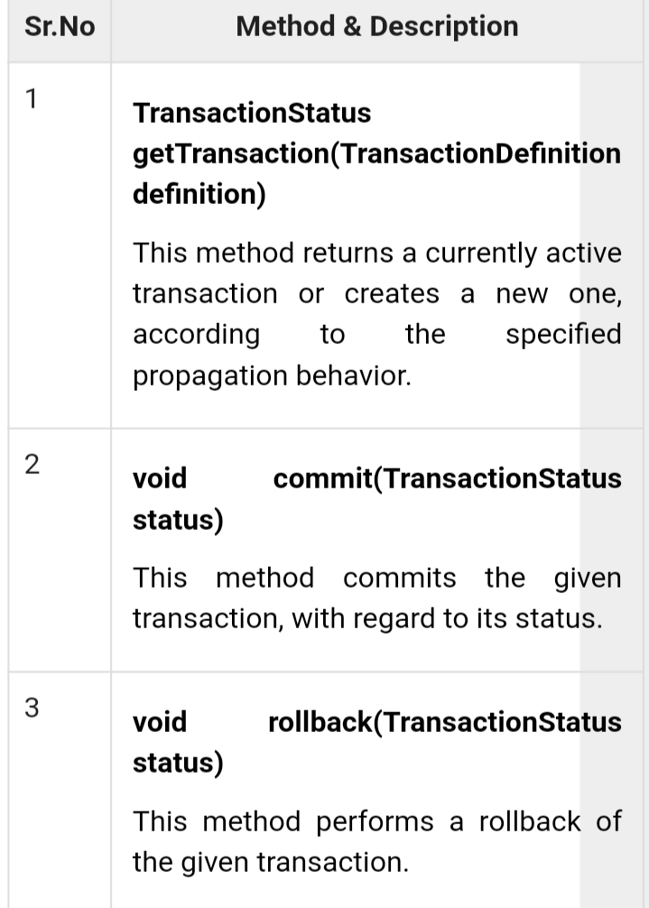

Slide 75
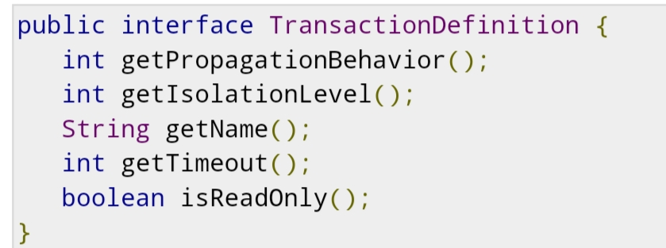
The TransactionDefinition is the core interface of the transaction support in Spring

Slide 76


Slide 77
Spring MVC
A Spring MVC is a Java framework which is used to build web applications.
It follows the Model-View-Controller design pattern. It implements all the basic features of a core spring framework like Inversion of Control, Dependency Injection.
A Spring MVC provides an elegant solution to use MVC in spring framework by the help of DispatcherServlet.
Here, DispatcherServlet is a class that receives the incoming request and maps it to the right resource such as controllers, models, and views.

Slide 78


Slide 79
Model - A model contains the data of the application. A data can be a single object or a collection of objects.
Controller - A controller contains the business logic of an application. Here, the @Controller annotation is used to mark the class as the controller.
View - A view represents the provided information in a particular format. Generally, JSP+JSTL is used to create a view page. Although spring also supports other view technologies such as Apache Velocity, Thymeleaf and FreeMarker.
Front Controller - In Spring Web MVC, the DispatcherServlet class works as the front controller. It is responsible to manage the flow of the Spring MVC application.

Slide 80

Understanding the flow of Spring Web MVC

Slide 81
Advantages of Spring MVC Framework
Separate roles - The Spring MVC separates each role, where the model object, controller, command object, view resolver, DispatcherServlet, validator, etc. can be fulfilled by a specialized object.
Light-weight - It uses light-weight servlet container to develop and deploy your application.
Powerful Configuration - It provides a robust configuration for both framework and application classes that includes easy referencing across contexts, such as from web controllers to business objects and validators.
Rapid development - The Spring MVC facilitates fast and parallel development.
Reusable business code - Instead of creating new objects, it allows us to use the existing business objects.
Easy to test - In Spring, generally we create JavaBeans classes that enable you to inject test data using the setter methods.
Flexible Mapping - It provides the specific annotations that easily redirect the page.
Spring Web MVC Framework Example

Slide 82
What is Spring DispatcherServlet
DispatcherServlet acts as front controller for Spring based web applications. It provides a mechanism for request processing where actual work is performed by configurable, delegate components.
It is inherited from javax.servlet.http.HttpServlet, it is typically configured in the web.xml file.
A web application can define any number of DispatcherServlet instances.
Each servlet will operate in its own namespace, loading its own application context with mappings, handlers, etc. Only the root application context as loaded by ContextLoaderListener, if any, will be shared. In most cases, applications have only single DispatcherServlet with the context-root URL(/), that is, all requests coming to that domain will be handled by it.
DispatcherServlet uses Spring configuration classes to discover the delegate components it needs for request mapping, view resolution, exception handling etc.

Slide 83
How it uses WebApplicationContext
WebApplicationContext is an extension of a plain ApplicationContext. it is web aware ApplicationContext i.e it has Servlet Context information.
When DispatcherServlet is loaded, it looks for the bean configuration file of WebApplicationContext and initializes it.
By having access to Servlet context, any spring bean which implement ServletConextAware interface – can get access to ServletContext instance and do many things with it.
For example, it can get context init parameters, get context root information and get resources location inside web application folders.

Slide 84


Slide 85


Slide 86


Slide 87

SPRING BOOT ARCHITECTURE

Slide 88


Slide 89


Slide 90


Slide 91


Slide 92


Slide 93
MAVEN
Maven is a powerful project management tool that is based on POM (project object model). It is used for projects build, dependency and documentation.
It simplifies the build process like ANT. But it is too much advanced than ANT.

Slide 94
Maven simplifies the above mentioned problems. It does mainly following tasks.
It makes a project easy to build
It provides uniform build process (maven project can be shared by all the maven projects)
It provides project information (log document, cross referenced sources, mailing list, dependency list, unit test reports etc.)
It is easy to migrate for new features of Maven

Slide 95
A build tool takes care of everything for building a process. It does following:
Generates source code (if auto-generated code is used)
Generates documentation from source code
Compiles source code
Packages compiled code into JAR of ZIP file
Installs the packaged code in local repository, server repository, or central repository

Slide 96
How to install Maven on windows
You can download and install maven on windows, linux and MAC OS platforms. Here, we are going to learn how to install maven on windows OS.
To install maven on windows, you need to perform following steps:
Download maven and extract it
Add JAVA_HOME and MAVEN_HOME in environment variable
Add maven path in environment variable
Verify Maven

Slide 97


Slide 98
Maven Repository
A maven repository is a directory of packaged JAR file with pom.xml file. Maven searches for dependencies in the repositories. There are 3 types of maven repository:
Local Repository
Central Repository
Remote Repository

Slide 99


Slide 100




Slide 101


Slide 102


Slide 103


Slide 104


Slide 105
Maven Plugins
The maven plugins are central part of maven framework, it is used to perform specific goal.
According to Apache Maven, there are 2 types of maven plugins.
Build Plugins
Reporting Plugins
Build Plugins
These plugins are executed at the time of build. These plugins should be declared inside the <build> element

Slide 106

Reporting Plugins

Slide 107


Slide 108


